Slide 1


OCP 11 Part 1 [1Z0-819]
Dr.-Ing Mohamed Amine Mezghich
Associate Professor at ENSI, CEO of Smart IT Partner
JAVA/J2EE Certified Trainer
ma.mezghich@smart-it-partner.com
amine.mezghich@ensi-uma.tn

Slide 2
Chapter 4 : Methods and Encapsulation
OCA EXAM OBJECTIVES COVERED IN THIS CHAPTER: ✓ Working with Methods and Encapsulation ■ Create methods with arguments and return values; including overloaded methods ■ Apply the static keyword to methods and fields ■ Create and overload constructors; include impact on default constructors ■ Apply access modifiers ■ Apply encapsulation principles to a class ■ Determine the effect upon object references and primitive values when they are passed into methods that change the values

Slide 3
Chapter 4 : Methods and Encapsulation
OCA EXAM OBJECTIVES COVERED IN THIS CHAPTER: ✓ Working with Selected classes from the Java API ■ Write a simple Lambda expression that consumes a Lambda Predicate expression

Slide 4
Chapter 4 : Methods and Encapsulation
OCA EXAM OBJECTIVES COVERED IN THIS CHAPTER: ✓ Working with Selected classes from the Java API ■ Write a simple Lambda expression that consumes a Lambda Predicate expression

Slide 5
Chapter 4 : Methods and Encapsulation
In previous chapters, we’ve used methods and constructors without examining them in detail. In this chapter, we’ll explore methods and constructors in depth and cover everything you need to know about them for the OCA exam. (Well, almost—Chapter 5, “Class Design,” will explain the effects of inheritance on both methods and constructors.)
This chapter discusses instance variables, the final keyword, access modifiers, and initialization. You’ll also learn how to write a simple lambda expression.

Slide 6
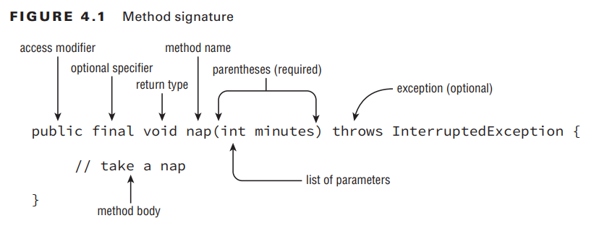
1-Designing Methods

Slide 7
1-Designing Methods
This is called a method declaration, which specifies all the information needed to call the method. There are a lot of parts, and we’ll cover each one in more detail.
Table 4.1 is a brief reference to the elements of a method declaration. Don’t worry if it seems like a lot of information—by the time you finish this chapter, it will all fit together.

Slide 8
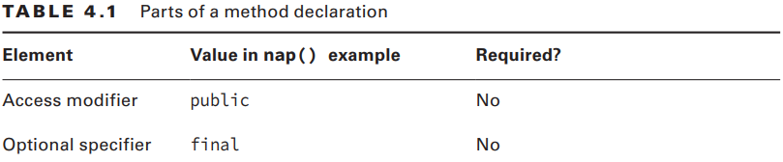
1-Designing Methods

Slide 9
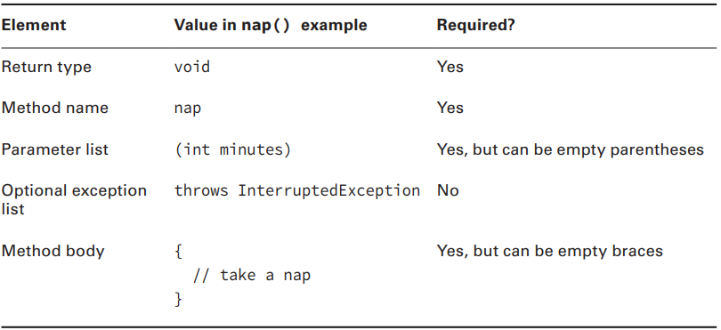
1-Designing Methods
To call this method, just type its name, followed by a single int value in parentheses: nap(10); Let’s start by taking a look at each of these parts of a basic method.

Slide 10
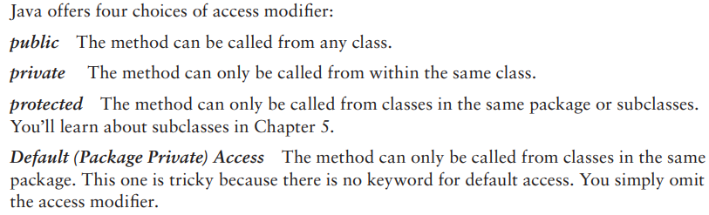
1-Designing Methods
1-1-Access Modifiers

Slide 11
1-Designing Methods
1-1-Access Modifiers Pay attention to the access modifiers as you figure out what is wrong with the ones that don’t compile: public void walk1() {} default void walk2() {} // DOES NOT COMPILE void public walk3() {} // DOES NOT COMPILE void walk4() {}

Slide 12
1-Designing Methods
1-2-Optional Specifiers There are a number of optional specifiers, but most of them aren’t on the exam. Optional specifiers come from the following list. Unlike with access modifiers, you can have multiple specifiers in the same method (although not all combinations are legal). When this happens, you can specify them in any order.
And since it is optional, you can’t have any of them at all. This means you can have zero or more specifiers in a method declaration.

Slide 13
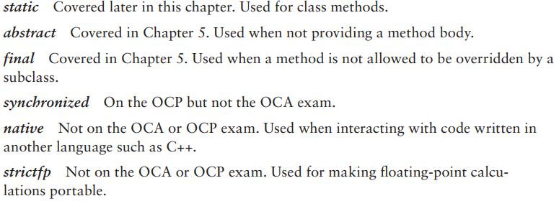
1-Designing Methods
1-2-Optional Specifiers

Slide 14
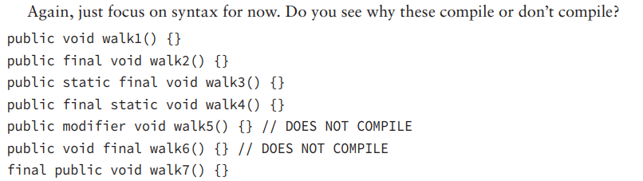
1-Designing Methods
1-2-Optional Specifiers
walk6() doesn’t compile because the optional specifier is after the return type.

Slide 15
1-Designing Methods
1-3-Return Type The next item in a method declaration is the return type. The return type might be an actual Java type such as String or int. If there is no return type, the void keyword is used. This special return type comes from the English language: void means without contents. In Java, we have no type there. Remember that a method must have a return type. If no value is returned, the return type is void. You cannot omit the return type.

Slide 16
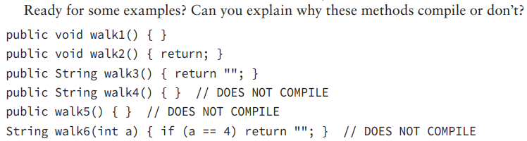
1-Designing Methods
walk6() is a little tricky. There is a return statement, but it doesn’t always get run. If a is 6, the return statement doesn’t get executed. Since the String always needs to be returned, the compiler complains.
1-3-Return Type

Slide 17
1-Designing Methods
1-4-Method Name Method names follow the same rules as we practiced with variable names in Chapter 1, “Java Building Blocks.” To review, an identifier may only contain letters, numbers, $, or _. Also, the first character is not allowed to be a number, and reserved words are not allowed. By convention, methods begin with a lowercase letter but are not required to. Since this is a review of Chapter 1, we can jump right into practicing with some examples:

Slide 18
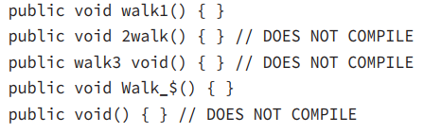
1-Designing Methods
1-4-Method Name

Slide 19
1-Designing Methods
1-5-Parameter List Although the parameter list is required, it doesn’t have to contain any parameters. This means you can just have an empty pair of parentheses after the method name, such as void nap(){}. If you do have multiple parameters, you separate them with a comma. There are a couple more rules for the parameter list that you’ll see when we cover varargs shortly. For now, let’s practice looking at method signatures with “regular” parameters:

Slide 20
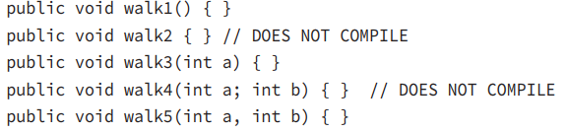
1-Designing Methods
1-5-Parameter List
walk4() doesn't compile because the parameters are separated by a semicolon rather than a comma. Semicolons are for separating statements, not parameter lists.

Slide 21
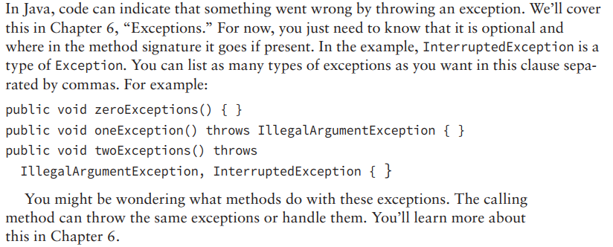
1-Designing Methods
1-6-Optional Exception List

Slide 22
1-Designing Methods
1-7-Method Body The final part of a method declaration is the method body (except for abstract methods and interfaces, but you don’t need to know about either of those until next chapter).
A method body is simply a code block. It has braces that contain zero or more Java statements. We’ve spent several chapters looking at Java statements by now, so you should find it easy to figure out why these compile or don’t:

Slide 23
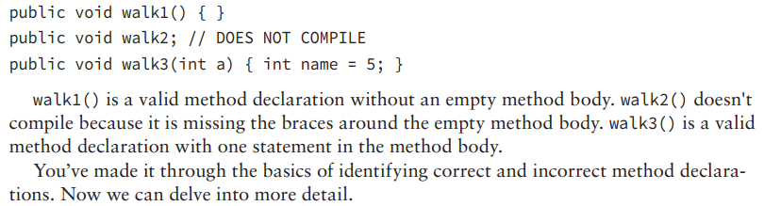
1-Designing Methods
1-7-Method Body

Slide 24
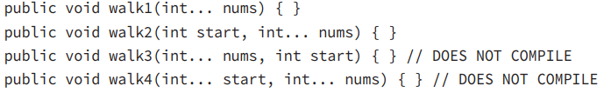
2-Working with Varargs
A vararg parameter must be the last element in a method’s parameter list. This implies you are only allowed to have one vararg parameter per method. Can you identify why each of these does or doesn’t compile? (Yes, there is a lot of practice in this chapter. You have to be really good at identifying valid and invalid methods for the exam.)

Slide 25
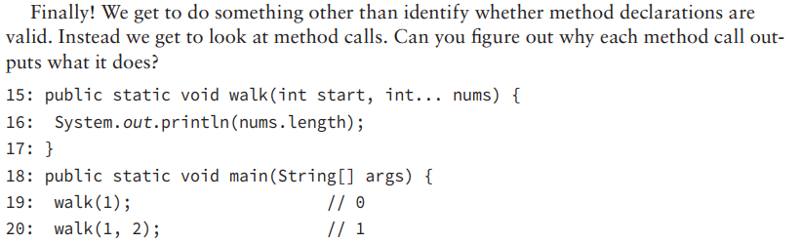
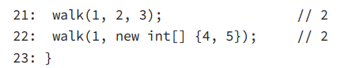
2-Working with Varargs

Slide 26
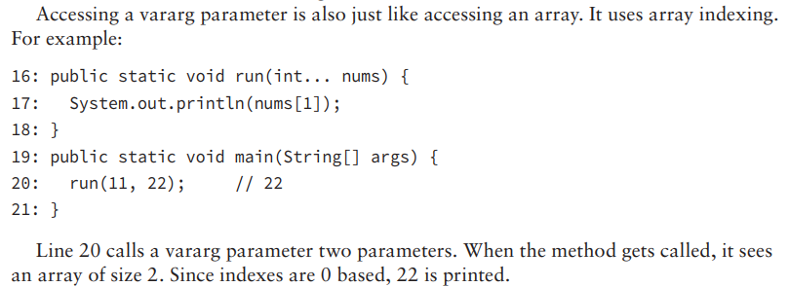
2-Working with Varargs

Slide 27
3-Applying Access Modifiers
You already saw that there are four access modifiers: public, private, protected, and default access. We are going to discuss them in order from most restrictive to least restrictive: ■ private: Only accessible within the same class ■ default (package private) access: private and other classes in the same package ■ protected: default access and child classes ■ public: protected and classes in the other packages

Slide 28
3-Applying Access Modifiers
3-1-Private Access Private access is easy. Only code in the same class can call private methods or access private fields.
Before we start, take a look at Figure 4.2. It shows the classes we’ll use to explore private and default access. The big boxes are the names of the packages. The smaller boxes inside them are the classes in each package. You can refer back to this figure if you want to quickly see how the classes relate.

Slide 29
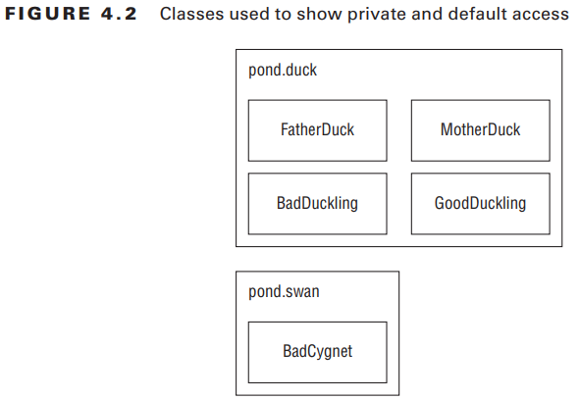
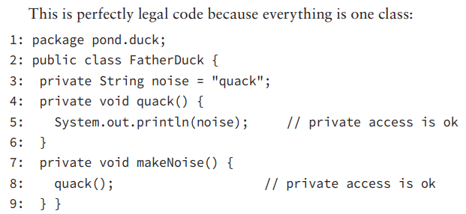
3-Applying Access Modifiers
3-1-Private Access

Slide 30
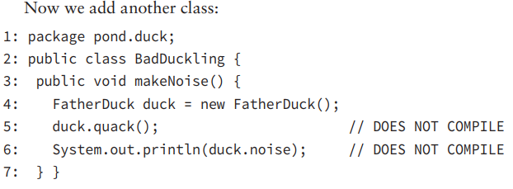
3-Applying Access Modifiers
3-1-Private Access

Slide 31
3-Applying Access Modifiers
3-2-Default (Package Private) Access
When there is no access modifier, Java uses the default, which is package private access. This means that the member is “private” to classes in the same package. In other words, only classes in the package may access it.

Slide 32
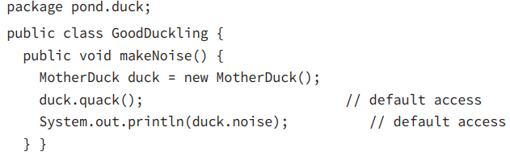
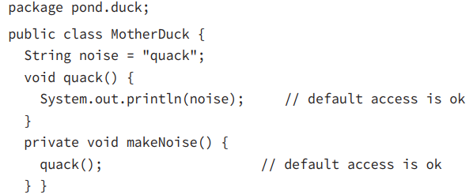
3-Applying Access Modifiers
3-2-Default (Package Private) Access

Slide 33
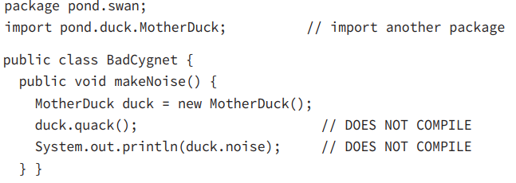
3-Applying Access Modifiers
3-2-Default (Package Private) Access

Slide 34
3-Applying Access Modifiers
3-3-Protected Access Protected access allows everything that default (package private) access allows and more. The protected access modifier adds the ability to access members of a parent class. We’ll cover creating subclasses in depth in Chapter 5. For now, we’ll cover the simplest possible use of a child class. Figure 4.3 shows the many classes we’ll create in this section. There are a number of classes and packages, so don’t worry about keeping them all in your head. Just check back with this figure as you go.

Slide 35
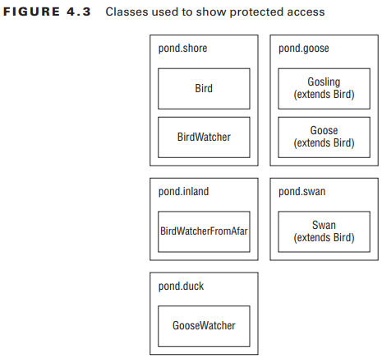
3-Applying Access Modifiers
3-3-Protected Access First, we create a Bird class and give
protected access to its members:

Slide 36
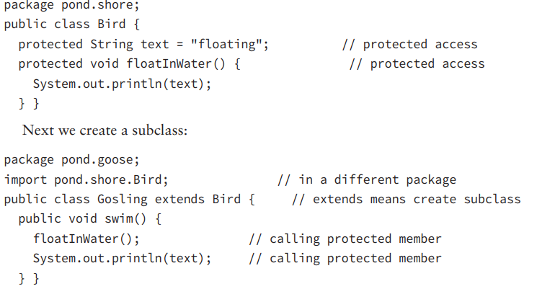
3-Applying Access Modifiers
3-3-Protected Access

Slide 37
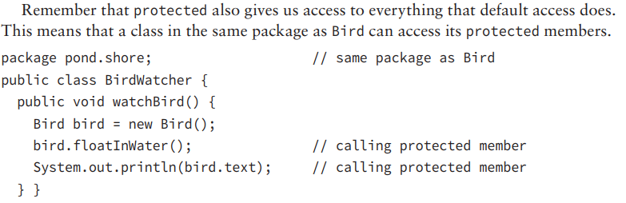
3-Applying Access Modifiers
3-3-Protected Access
The definition of protected allows access to subclasses and classes in the same package. This example uses the same package part of that definition.

Slide 38
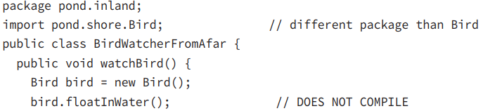
3-Applying Access Modifiers
3-3-Protected Access Now let’s try the same thing from a different package:
BirdWatcherFromAfar is not in the same package as Bird and it doesn’t inherit from Bird. This means that it is not allowed to access protected members of Bird. Got that? Subclasses and classes in the same package are the only ones allowed to access protected members.

Slide 39
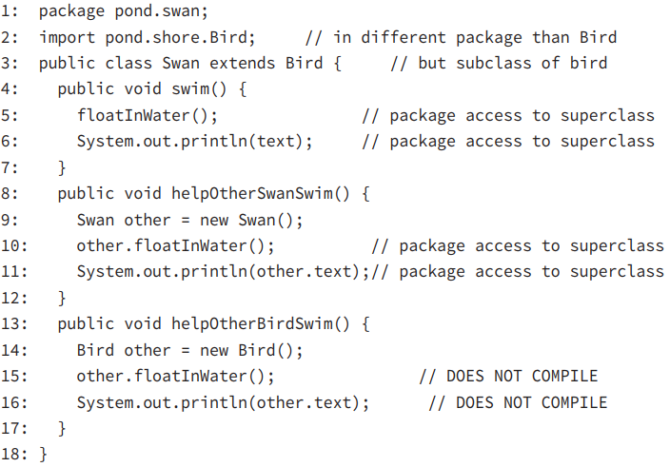
3-Applying Access Modifiers
3-3-Protected Access There is one gotcha for protected access. Consider this class:

Slide 40
3-Applying Access Modifiers
3-4-Public Access Protected access was a tough concept. Luckily, the last type of access modifier is easy: public means anyone can access the member from anywhere. package pond.duck; public class DuckTeacher { public String name = "helpful"; // public access public void swim() { // public access System.out.println("swim"); } }

Slide 41
3-Applying Access Modifiers
3-4-Public Access DuckTeacher allows access to any class that wants it. Now we can try it out: package pond.goose; import pond.duck.DuckTeacher; public class LostDuckling { public void swim() { DuckTeacher teacher = new DuckTeacher(); teacher.swim(); // allowed System.out.println("Thanks" + teacher.name); // allowed } }

Slide 42
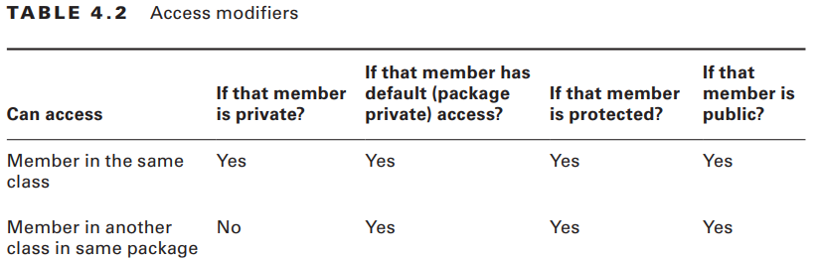
3-Applying Access Modifiers

Slide 43
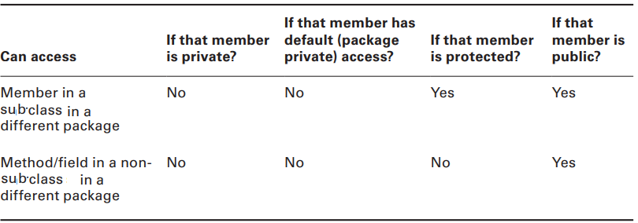
3-Applying Access Modifiers

Slide 44
3-Applying Access Modifiers
3-5-Designing Static Methods and Fields Except for the main() method, we’ve been looking at instance methods. Static methods don’t require an instance of the class. They are shared among all users of the class. You can think of statics as being a member of the single class object that exist independently of any instances of that class.

Slide 45
3-Applying Access Modifiers
3-5-Designing Static Methods and Fields We have seen one static method since Chapter 1. The main() method is a static method. That means you can call it by the classname. public class Koala { public static int count = 0; // static variable public static void main(String[] args) { // static method System.out.println(count); } }

Slide 46
3-Applying Access Modifiers
3-6-Calling a Static Variable or Method We said that the JVM basically calls Koala.main() to get the program started. You can do this too. We can have a KoalaTester that does nothing but call the main() method. public class KoalaTester { public static void main(String[] args) { Koala.main(new String[0]); // call static method } }

Slide 47
3-Applying Access Modifiers
3-5-Designing Static Methods and Fields Usually, accessing a static member is easy. You just put the classname before the method or variable and you are done. For example: System.out.println(Koala.count); Koala.main(new String[0]);

Slide 48
3-Applying Access Modifiers
3-5-Designing Static Methods and Fields One more time because this is really important: what does the following output? Koala.count = 4; Koala koala1 = new Koala(); Koala koala2 = new Koala(); koala1.count = 6; koala2.count = 5; System.out.println(Koala.count); Hopefully, you answered 5. There is only one count variable since it is static. It is set to 4, then 6, and finally winds up as 5. All the Koala variables are just distractions.

Slide 49
3-Applying Access Modifiers
3-7-Static vs. Instance There’s another way the exam creators will try to trick you regarding static and instance members. (Remember that “member” means field or method.) A static member cannot call an instance member. This shouldn’t be a surprise since static doesn’t require any instances of the class to be around. The following is a common mistake for rookie programmers to make:

Slide 50
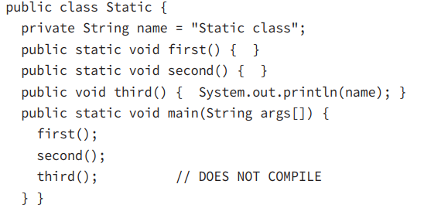
3-Applying Access Modifiers
3-7-Static vs. Instance

Slide 51
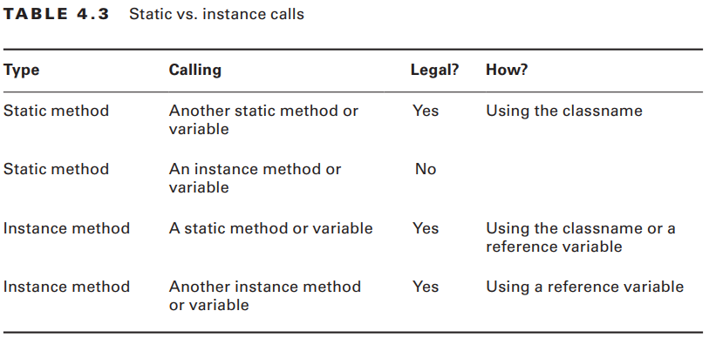
3-Applying Access Modifiers
3-7-Static vs. Instance

Slide 52
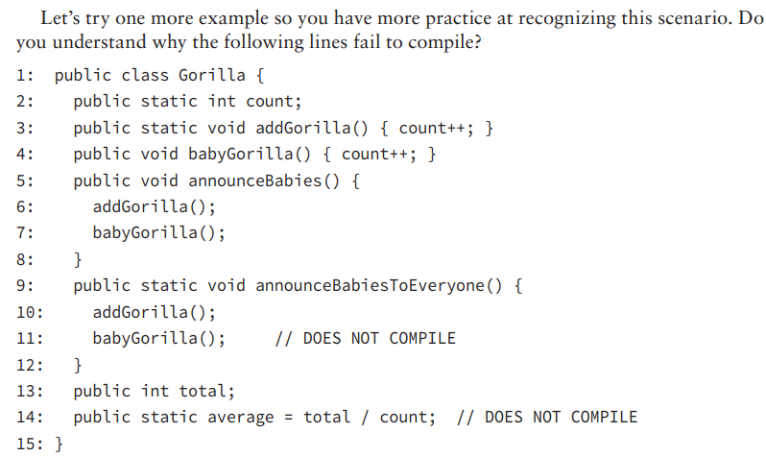
3-Applying Access Modifiers
3-7-Static vs. Instance

Slide 53
3-Applying Access Modifiers
3-8-Static Variables Some static variables are meant to change as the program runs. Counters are a common example of this. We want the count to increase over time. Just as with instance variables, you can initialize a static variable on the line it is declared: public class Initializers { private static int counter = 0; // initialization } Other static variables are meant to never change during the program. This type of variable is known as a constant. It uses the final modifier to ensure the variable never changes.

Slide 54
3-Applying Access Modifiers
3-8-Static Variables static final constants use a different naming convention than other variables. They use all uppercase letters with underscores between “words.” For example: public class Initializers { private static final int NUM_BUCKETS = 45; public static void main(String[] args) { NUM_BUCKETS = 5; // DOES NOT COMPILE } } The compiler will make sure that you do not accidentally try to update a final variable. This can get interesting. Do you think the following compiles?

Slide 55
3-Applying Access Modifiers
3-8-Static Variables private static final ArrayList<String> values = new ArrayList<>(); public static void main(String[] args) { values.add("changed"); } It actually does compile. values is a reference variable. We are allowed to call methods on reference variables. All the compiler can do is check that we don’t try to reassign the final values to point to a different object.

Slide 56
3-Applying Access Modifiers
3-9-Static Initialization In Chapter 1, we covered instance initializers that looked like unnamed methods. Just code inside braces. Static initializers look similar. They add the static keyword to specify they should be run when the class is first used. For example: private static final int NUM_SECONDS_PER_HOUR; static { int numSecondsPerMinute = 60; int numMinutesPerHour = 60; NUM_SECONDS_PER_HOUR = numSecondsPerMinute * numMinutesPerHour; }

Slide 57
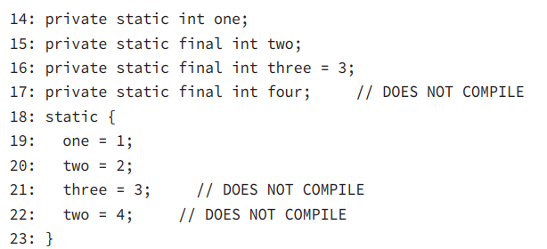
3-Applying Access Modifiers
3-9-Static Initialization
Line 17 declares a final variable that never gets initialized. The compiler gives a compiler error because it knows that the static blocks are the only place the variable could possibly get initialized. Since the programmer forgot, this is clearly an error.

Slide 58
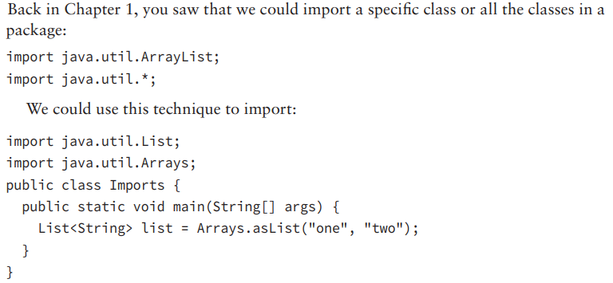
3-Applying Access Modifiers
3-10-Static Imports

Slide 59
3-Applying Access Modifiers
3-10-Static Imports The previous method has one static method call: Arrays.asList. Rewriting the code to use a static import yields the following: import java.util.List; import static java.util.Arrays.asList; // static import public class StaticImports { public static void main(String[] args) { List<String> list = asList("one", "two"); // no Arrays. } }

Slide 60
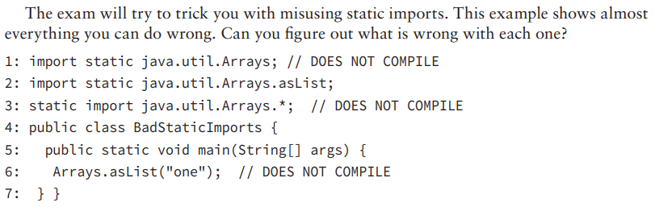
3-Applying Access Modifiers
3-10-Static Imports

Slide 61
4-Passing Data Among Methods
Java is a “pass-by-value” language. This means that a copy of the variable is made and the method receives that copy. Assignments made in the method do not affect the caller. Let’s look at an example: 2: public static void main(String[] args) { 3: int num = 4; 4: newNumber(num); 5: System.out.println(num); // 4 6: } 7: public static void newNumber(int num) { 8: num = 8; 9: }

Slide 62
4-Passing Data Among Methods
Now that you’ve seen primitives, let’s try an example with a reference type. What do you think is output by the following code? public static void main(String[] args) { String name = "Webby"; speak(name); System.out.println(name); } public static void speak(String name) { name = "Sparky"; }
The correct answer is Webby. Just as in the primitive example, the variable assignment is only to the method parameter and doesn’t affect the caller.

Slide 63
4-Passing Data Among Methods
As an example, we have code that calls a method on the StringBuilder passed into the method: public static void main(String[] args) { StringBuilder name = new StringBuilder(); speak(name); System.out.println(name); // Webby } public static void speak(StringBuilder s) { s.append("Webby"); }
s is a copy of the variable name. Both point to the same StringBuilder, which means that changes made to the StringBuilder are available to both references.

Slide 64
4-Passing Data Among Methods
To review, Java uses pass-by-value to get data into a method. Assigning a new primitive or reference to a parameter doesn’t change the caller. Calling methods on a reference to an object does affect the caller.

Slide 65
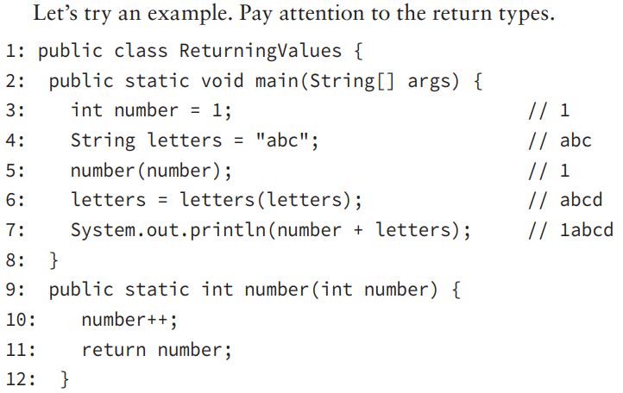
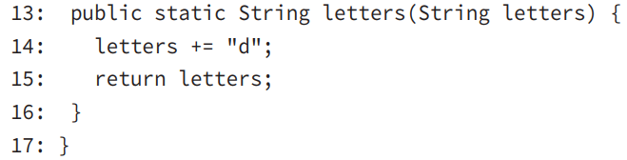
4-Passing Data Among Methods

Slide 66
5-Overloading Methods
5-1-Overloading and Varargs Now that you are familiar with the rules for declaring methods, it is time to look at creating methods with the same signature in the same class. Method overloading occurs when there are different method signatures with the same name but different type parameters.

Slide 67
5-Overloading Methods
5-1-Overloading and Varargs Now that you are familiar with the rules for declaring methods, it is time to look at creating methods with the same signature in the same class. Method overloading occurs when there are different method signatures with the same name but different type parameters.

Slide 68
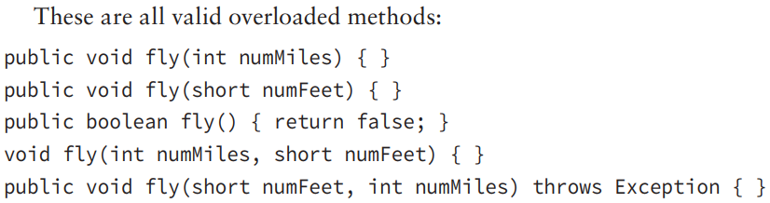
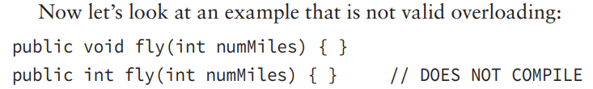
5-Overloading Methods
5-1-Overloading and Varargs

Slide 69
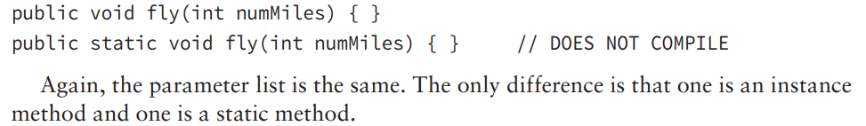
5-Overloading Methods
5-1-Overloading and Varargs

Slide 70
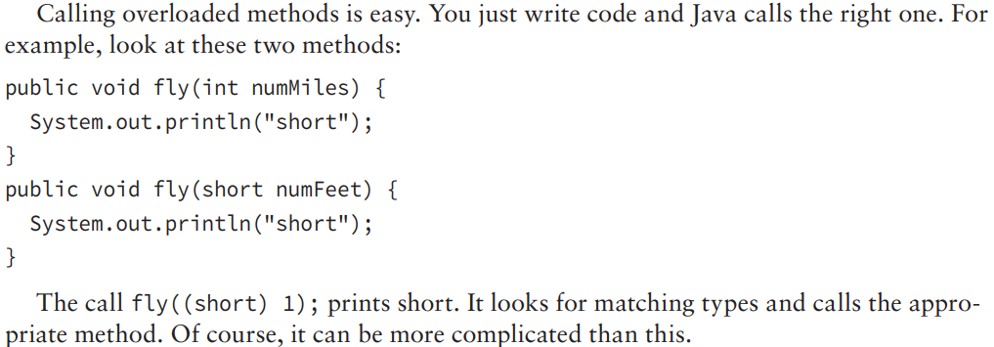
5-Overloading Methods
5-1-Overloading and Varargs

Slide 71
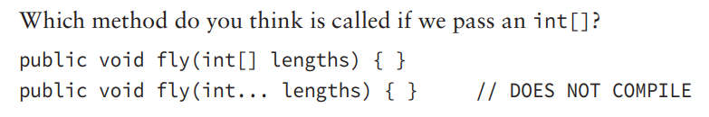
5-Overloading Methods
5-1-Overloading and Varargs

Slide 72
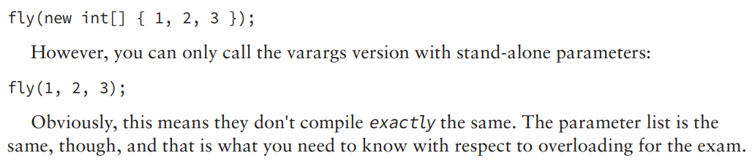
5-Overloading Methods
5-1-Overloading and Varargs

Slide 73
5-Overloading Methods
5-2-Autoboxing In the previous chapter, you saw how Java will convert a primitive int to an object Integer to add it to an ArrayList through the wonders of autoboxing. This works for code you write too. public void fly(Integer numMiles) { } This means calling fly(3); will call the previous method as expected. However, what happens if we have both a primitive and an integer version?

Slide 74
5-Overloading Methods
5-2-Autoboxing public void fly(int numMiles) { } public void fly(Integer numMiles) { } Java will match the int numMiles version. Java tries to use the most specific parameter list it can find. When the primitive int version isn't present, it will autobox. However, when the primitive int version is provided, there is no reason for Java to do the extra work of autoboxing.

Slide 75
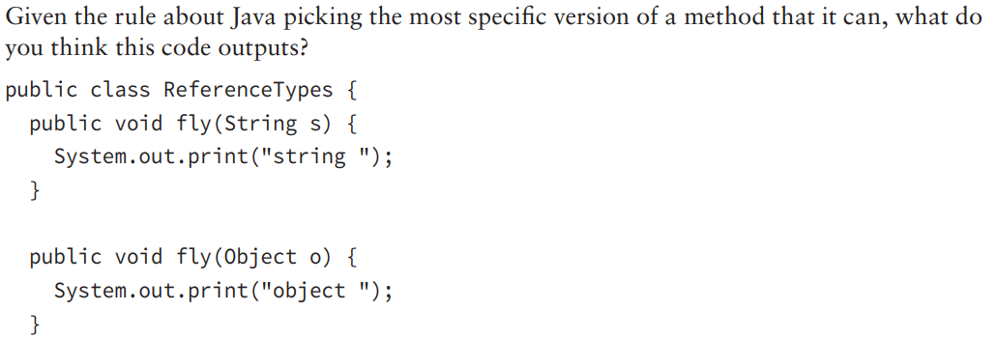
5-Overloading Methods
5-3-Reference Types

Slide 76
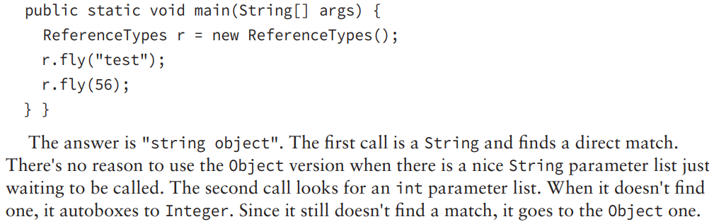
5-Overloading Methods
5-3-Reference Types

Slide 77
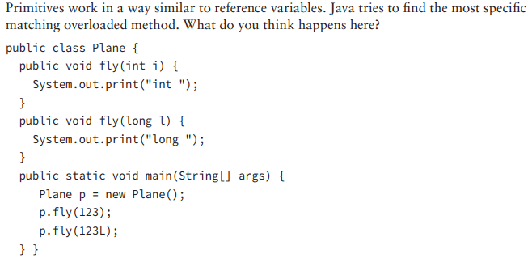
5-Overloading Methods
5-4-Primitives
The answer is int long.

Slide 78
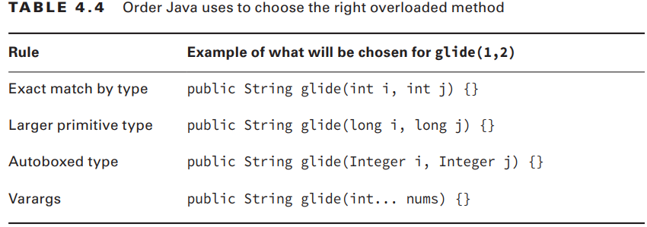
5-Overloading Methods
5-5-Putting It All Together

Slide 79
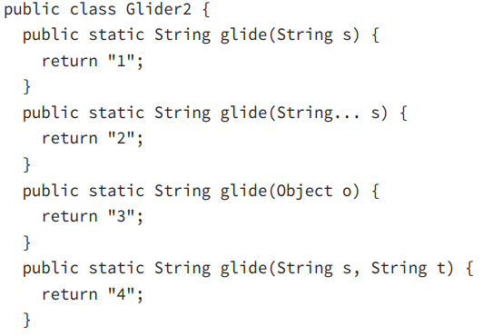
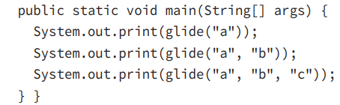
5-Overloading Methods
5-5-Putting It All Together

Slide 80
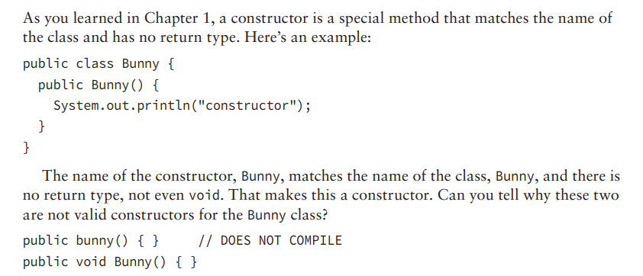
5-Overloading Methods
5-6-Creating Constructors

Slide 81
5-Overloading Methods
5-6-Creating Constructors Now let's look at some examples that aren't common but that you might see on the exam: 1: public class Bunny { 2: private String color; 3: private int height; 4: private int length; 5: public Bunny(int length, int theHeight) { 6: length = this.length; // backwards – no good! 7: height = theHeight; // fine because a different name 8: this.color = "white"; // fine, but redundant 9: } 10: public static void main(String[] args) { 11: Bunny b = new Bunny(1, 2); 12: System.out.println(b.length + " " + b.height + " " + b.color); 13: } }

Slide 82
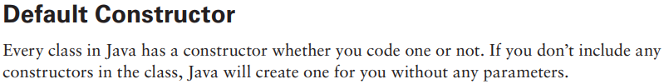
5-Overloading Methods
5-6-Creating Constructors

Slide 83

5-Overloading Methods
5-6-Creating Constructors

Slide 84

5-Overloading Methods
5-6-Creating Constructors

Slide 85


5-Overloading Methods
5-6-Creating Constructors

Slide 86

5-Overloading Methods
5-6-Creating Constructors

Slide 87

5-Overloading Methods

Slide 88


5-Overloading Methods

Slide 89


5-Overloading Methods

Slide 90

5-Overloading Methods

Slide 91

5-Overloading Methods

Slide 92

5-Overloading Methods

Slide 93

5-Overloading Methods

Slide 94

5-Overloading Methods

Slide 95

5-Overloading Methods

Slide 96

6-Writing Simple Lambdas

Slide 97

6-Writing Simple Lambdas

Slide 98

6-Writing Simple Lambdas

Slide 99

6-Writing Simple Lambdas

Slide 100

6-Writing Simple Lambdas

Slide 101

6-Writing Simple Lambdas

Slide 102


6-Writing Simple Lambdas

Slide 103

6-Writing Simple Lambdas

Slide 104

6-Writing Simple Lambdas

Slide 105

6-Writing Simple Lambdas

Slide 106

6-Writing Simple Lambdas

Slide 107

6-Writing Simple Lambdas

Slide 108

6-Writing Simple Lambdas

Slide 109

6-Writing Simple Lambdas

Slide 110

6-Writing Simple Lambdas

